Slide 1
Migraine in Schools:
Not Just a Headache!
Cynthia Morris, MD
Assistant Professor of Pediatric Neurology
SSM Cardinal Glennon Children’s Hospital
St. Louis, MO

Slide 2
Disclosure
I have no relevant financial relationships to disclose.

Slide 3
Objectives
Describe common features of migraine
Discuss treatment approaches for migraine
Discuss helpful school accommodations for children with migraine

Slide 4
Why migraine?
>47 million americans have migraine - leading cause of years lived with disability in people under the age of 50 worldwide
10% children 4-11yo are diagnosed with migraine.
27% of females and 20% of males age 12-18 are diagnosed with migraine.
Headache is the third most common illness related cause of school absenteeism in the U.S.
Children with migraine have decreased school performance and impaired quality of life, similar to that of children with rheumatoid arthritis or cancer.

Slide 5
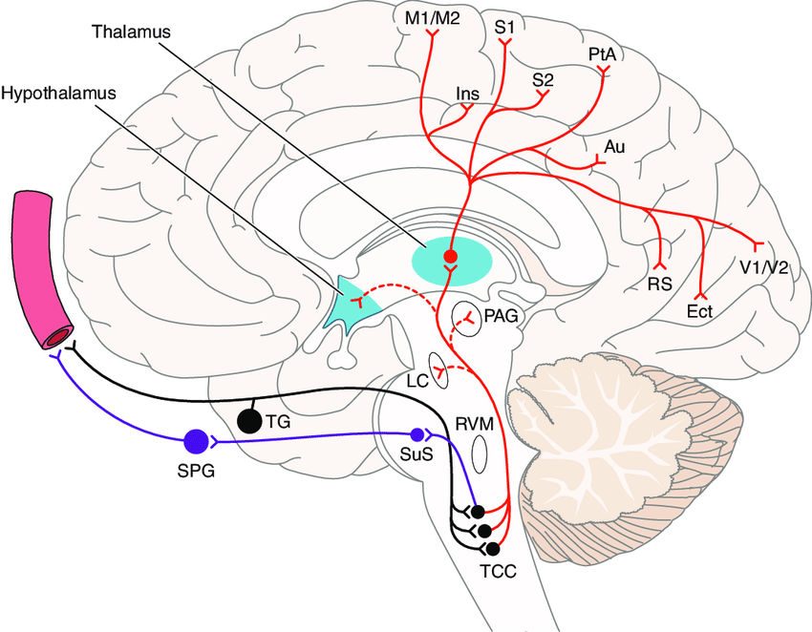
What is migraine?
Genetically determined disease where patients have a “sensitive” brain
The pathways that normally conduct head pain and response to outside stimuli are too easily activated

Slide 6
A bit of reframing
“Migraine” is a complex disorder, including not only headaches, but all the associated symptoms both during and between attacks
“Migraine attacks” are the episodes of headaches and/or other symptoms that patients experience
Think of it like asthma – you would not say someone is having an “asthma” with difficulty breathing

Slide 7
Diagnostic criteria
Migraine without aura
At least 5 attacks fulfilling criteria B-D
Headache attacks lasting 4-72 hr (untreated or unsuccessfully treated) 2+ in kids
Headache has at least 2 of the following four characteristics:
Unilateral location Often bilateral
Pulsating quality
Moderate or severe pain intensity
Aggravation by or causing avoidance of routine physical activity
During headache at least one of the following
Nausea and/or vomiting
Photophobia AND phonophobia
Not better accounted for by another ICHD-3 diagnosis

Slide 8
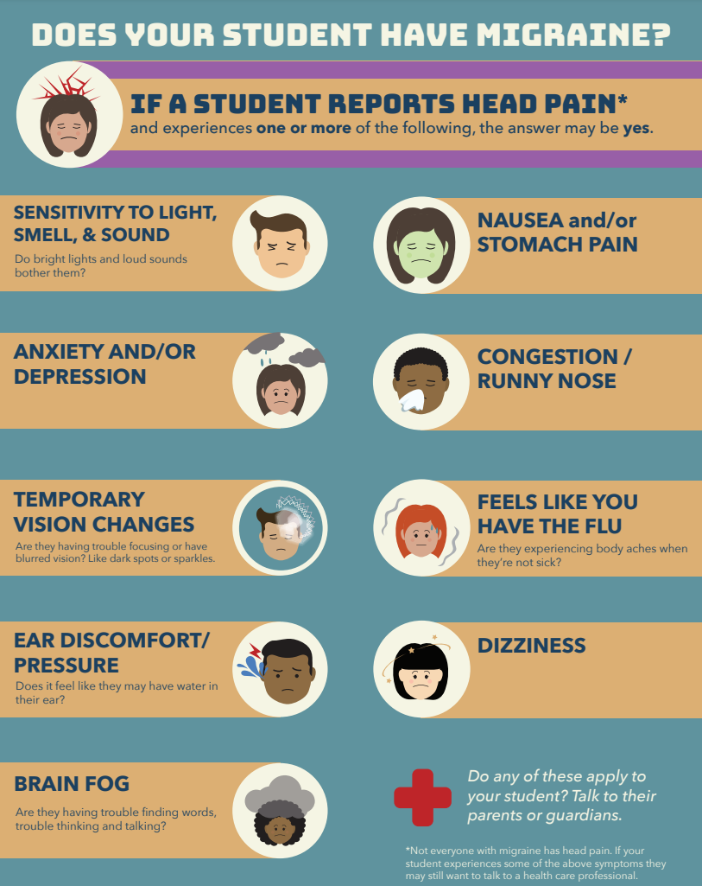

Slide 9
Oof that’s a lot of symptoms
The ID Migraine tool is your friend - “PIN” down the diagnosis
P - photophobia
I - impairment
Does the patient feel impaired or avoid activities when they have a headache?
N - nausea
Is nausea present with the patient’s headaches?
2/3 symptoms = 93% PPV
3/3 symptoms = 98% PPV

Slide 10
Migraine prodrome and postdrome
Kids can be symptomatic hours to days before and after their attacks
Prodrome: Fatigue, irritability, insomnia, diarrhea, trouble concentrating, neck stiffness, increased thirst/urination, anorexia, yawning
Postdrome: fatigue, difficulty concentrating, stiff neck, prolonged mild pain.

Slide 11
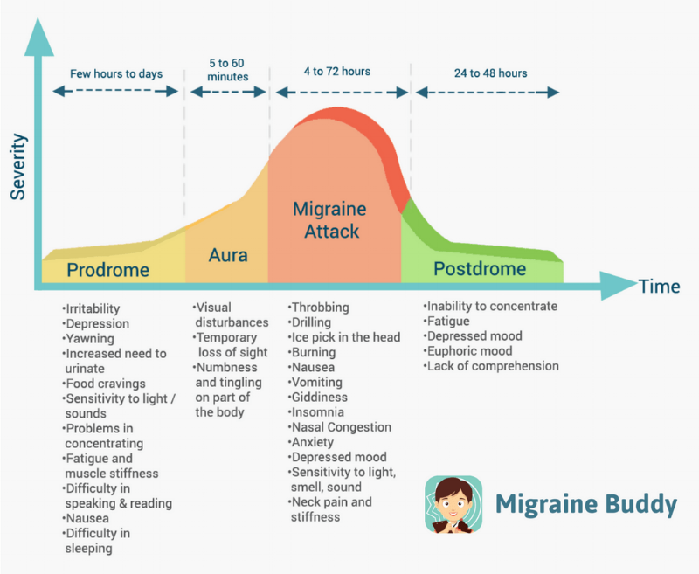

Slide 12
Common triggers
Stress
Weather change
Loud sounds/bright lights
Strong smells
Exercise
Hormones
Hunger
Caffeine
Medications
Season changes
Poor sleep
Etc, etc…

Slide 13
Comorbidities: Anxiety and Depression
Numerous studies note a significant association between primary headache disorders and anxiety/depression in children as young as 4 years of age

Slide 14
We’ve made the diagnosis -
now what?

Slide 15
Treatment
Lifestyle optimization is a major part of overall headache management.
Good water intake
Regular meals
Adequate sleep
Regular exercise
Stress regulation

Slide 16
Acute Treatment
Often a combination of NSAID, Triptan, and nausea medication
NSAID: Ibuprofen, naproxen, diclofenac
Triptans: Imitrex, Maxalt, Zomig, Axert
Nausea: Zofran (ondansetron), Compazine, Reglan
Important to be given near the onset of a migraine attack for highest efficacy.
Goal is headache freedom within an hour, allowing patients to return to regular activities.
Acute medications can generally be safely given at the same time, and may even work better than when taken alone

Slide 17
Preventive treatment
Students experiencing more than one headache a week or with particular disability due to headaches may also be started on a daily preventive medication
These are taken on a scheduled basis every day regardless if the patient has a headache, with the goal of decreasing the total number of headaches.
Long list, including supplements, prescription, and injections
Non-medication treatments: physical therapy, cognitive behavioral therapy (CBT), acupuncture

Slide 18
Migraines in school

Slide 19
What makes school hard with migraine?
Early start times
Lights and noise
Unpredictability
Limitations to drink/food access
Screen time
Academic stress
Bullying/social stressors

Slide 20
Most important way school can help?
Believe your students when they complain of headaches
Migraine is often a “ silent” disease with no testable outward findings, so child reported pain may be doubted, leading to shame and frustration.
Clinical judgement is allowed, of course, but err on the side of benefit of the doubt

Slide 21
How the school can help
Be supportive of lifestyle factors
Allow carrying water bottles
Let parents access school menus - can send lunch on days students might not like the lunch
Open informative communication
Let families know if students aren’t eating well, falling asleep in class, feel fatigued
Stress management
Check in at particularly stressful times
Involve school counselors if needed

Slide 22
Accommodations
Follow student specific accommodations:
Allow wearing sunglasses
Excuse from noisy/loud rooms during migraine attack
Quiet testing rooms
Allow to rest after taking medications
Breaks during testing/modified homework load/schedule

Slide 23
Follow acute treatment plan
Acute medications should be given as close to pain onset as possible
Medications are less effective given later, don’t wait until pain is severe or more time has passed to medicate.
Allow at least 15-30 minutes after giving medications.
If treated appropriately, often students can return to class
Look for patterns in frequent fliers
Any particular time of day, how often taking pain medications, key associated symptoms, impact on school performance, bullying, anxiety, SI
Vomiting is often part of migraine, and generally not due to an infectious cause
Should not be sent home for this

Slide 24
Non-medication options for nausea
Huge problem for many patients, at times more disabling than the headache itself
Aromatherapy
Peppermint and lavender
Alcohol swabs - inhale scent

Slide 25
Chronic migraine
Migraine can be very debilitating
At times, students are so disabled they require full homebound schooling for a period of time.
Ideal goal is to return to school full time, though this can take patience and creativity
Work with student and family to create realistic hybrid model that can help with a gradual return to school.
Consider later start times, core classes later in the day, or alternating half days

Slide 26
Chronic migraine =/= unable to participate
Important to support social/non-academic activities
Chronic headaches can limit school attendance/participation
If possible, this should not result in limiting participation in extracurricular activities
Chronic migraine can be extremely isolating, participation in activities can help prevent depression and improve overall disease burden

Slide 27
Side note about chronic migraine
Students who are in chronic pain for prolonged periods can become acclimated to their discomfort and may not show their pain and other symptoms as obviously as students with more intermittent headaches.
Especially important to trust and work with these students, as they are at highest risk of disability and interference with overall life success.

Slide 28
504 Plan/Migraine Action Plan
Recommended for every student with migraine
Better to have in place before it is needed

Slide 29
Sample 504 plan
To Whom It May Concern:
NAME is a patient of mine at Cardinal Glennon Children’s Hospital. NAME is under my care for *** and was recently seen by me on ***. NAME is experiencing significant headache bourdon and at risk of severe disability from headache. I recommend a 504 plan to establish appropriate accommodations to maximize their learning opportunities.
Please initiate a 504 plan to include the following:
Hydration: Please allow opportunity for hydration, and keeping a water bottle with them. Please also allow trips to the bathroom as needed, as increased hydration has been encouraged.
Absences: I encourage school attendance when it is at all possible, however late arrivals, absences, and leaving early from school due to headaches should be excused. I encourage formulating an education plan that will allow them to attend half days of classes as needed without falling behind on academics - possibly with a hybrid home-bound model.
Medication: At onset or worsening of headache- Please allow them to take their acute medications and rest in a safe and quiet area at the nurse’s office, or a supervised equivalent. If requested, please allow them to contact their parent or guardian, should they need to be picked up.
Schedule: For their age group, 8-10 hours a night of sleep are recommended. The American Academy of Pediatrics recommends that high schools begin no earlier than 8:30 AM, in recognition of adolescents' physiologic tendency to go to bed later and wake later than younger children. I recommend scheduling their first period class as either an empty slot, or a course that can be flexibly attended (such as an art class). Adequate sleep is essential to headache management.

Slide 30
504 plan part 2
Assignments: Please allow extra time to complete assignments and exams, as productivity can be greatly reduced during headache. I recommend that their teachers limit the amount of homework they receive to only the volume that is needed to demonstrate learning of the material (for example, if 30 math problems are assigned to the class, perhaps have them just do the odd numbered ones). When possible, please give them assignments one week beforehand so that they can work on them when headaches are less disabling.
Computer Learning: Prolonged screen time can provoke a migraine headache. When possible, please provide materials that can be shifted to a paper format as opposed to completing electronically. Please allow frequent breaks from screen time to avoid worsening headaches.
Environment: Headaches can be exacerbated by movement, overheating, dehydration, light, sounds, and smell. If needed, they should be on modified PE. Please allow them to participate in physical activities as they are able, and allow rest/hydration as needed.
Privacy: While NAME's family is comfortable with teachers and relevant school personnel knowing about their condition, we appreciate your keeping their medical information confidential.
Other accommodations to be discussed by NAME, their family, and the school.
I plan to follow up regularly until we achieve control over the symptoms and are able to lessen disability. If you have any questions or concerns, please don't hesitate to call my office at ###-###-####

Slide 31
Useful websites
https://www.migraineatschool.org/
Lots of information and tools, particularly targeted towards families and school
Also great posters and handouts
https://www.headachereliefguide.com/
Detailed information on migraine for patients/families, and more details on lifestyle factors
https://www.milesformigraine.org/
Resource for education and support groups

Slide 32
Resources
Antonaci F, Voiticovschi-Iosob C, Di Stefano AL, Galli F, Ozge A, Balottin U. The evolution of headache from childhood to adulthood: a review of the literature. J Headache Pain. 2014;15(1):15.
Gofshteyn JS, Stephenson DJ. Diagnosis and management of childhood headache. Curr Probl Pediatr Adolesc Health Care. 2016;46(2):36-51.
GBD 2016 Neurology Collaborators. Global, regional, and national burden of neurological disorders, 1990-2016: a systematic analysis for the Global Burden of Disease Study 2016. Lancet Neurol. 2019;18(5):459-480.
Powers SW, Patton SR, Hommel KA, Hershey AD. Quality of life in childhood migraines: clinical impact and comparison to other chronic illnesses. Pediatrics. 2003;112(1 Pt 1):e1-5.
Szperka C. Headache in children and adolescents. Continuum (Minneap Minn). 2021;27(3):703-731.
Turner SB, Rende EK, Pezzuto T, et al. Pediatric migraine action plan(Pedmap). Headache. 2019;59(10):1871-1873.
Peretz AM, Minen MT, Cowan R, Strauss LD. Migraine action plan(Map). Headache. 2018;58(2):355-356.
Headache classification committee of the international headache society (Ihs) the international classification of headache disorders, 3rd edition. Cephalalgia. 2018;38(1):1-211.
Lipton RB, Dodick D, Sadovsky R, et al. A self-administered screener for migraine in primary care: The ID Migraine validation study. Neurology. 2003;61(3):375-382.

Slide 33
Questions? Cynthia.j.morris@health.slu.edu

Slide 35
Nutraceuticals
 | Dosage | Side Effects | Available forms
Riboflavin (Vitamin B2) | 400mg daily/200mg BID | Bright yellow urine | Only comes as pill
Melatonin | 3mg nightly | Drowsiness | Many different forms
Magnesium | 400-500mg per day (daily or divided BID) | Stomach cramping, diarrhea | Multiple forms including pill and gummies
Coenzyme Q10 (CoQ10) | 100mg BID | Some stomach upset | Only available as pill, can be more expensive
Notes:
Melatonin - impact regardless of sleep

